Slide 1
NSAC 15
Week 4 Project
By Azaaz Ashiq

Slide 2
Introduction / Concept
Specification
OOP-based web application
Read through the spec
Looks at MVP, built from there
Concept
JIRA
Create a list called Electric Vehicle
CRUD required

Slide 3
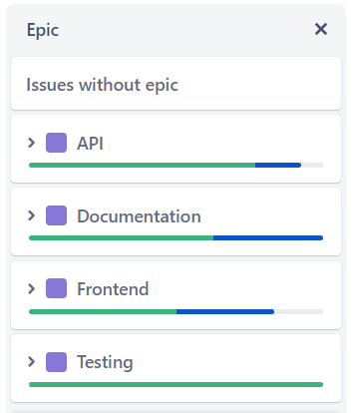
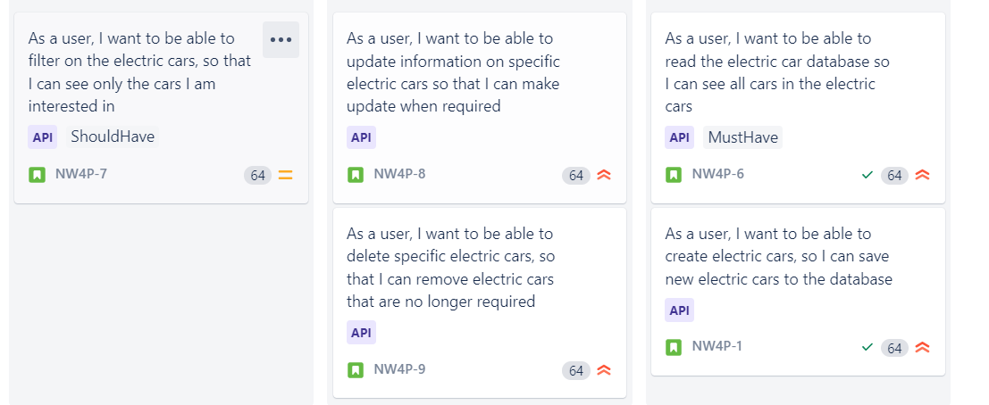
Sprint plan - JIRA https://azaazashiq.atlassian.net/jira/software/projects/NW4P/

Slide 4









Consultant Journey

Slide 5
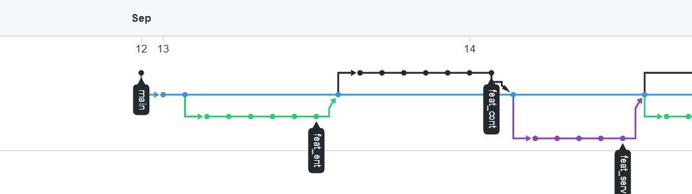
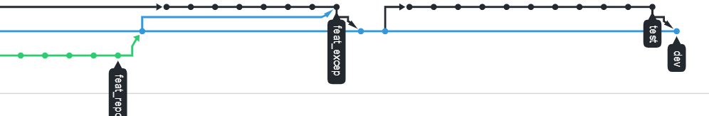
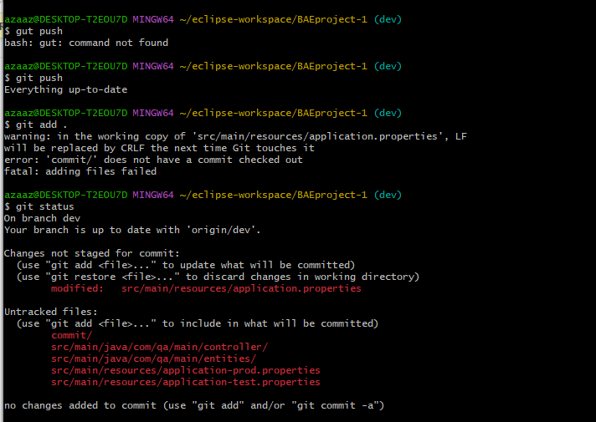
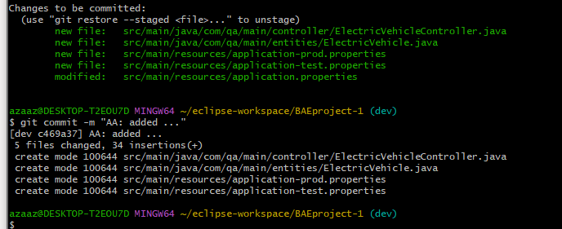
CI - GitHub
Github - https://github.com/Azaaz123/NsacWeek4Project.git

Slide 6
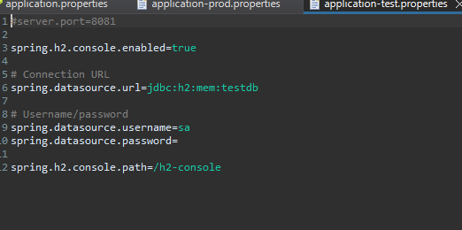
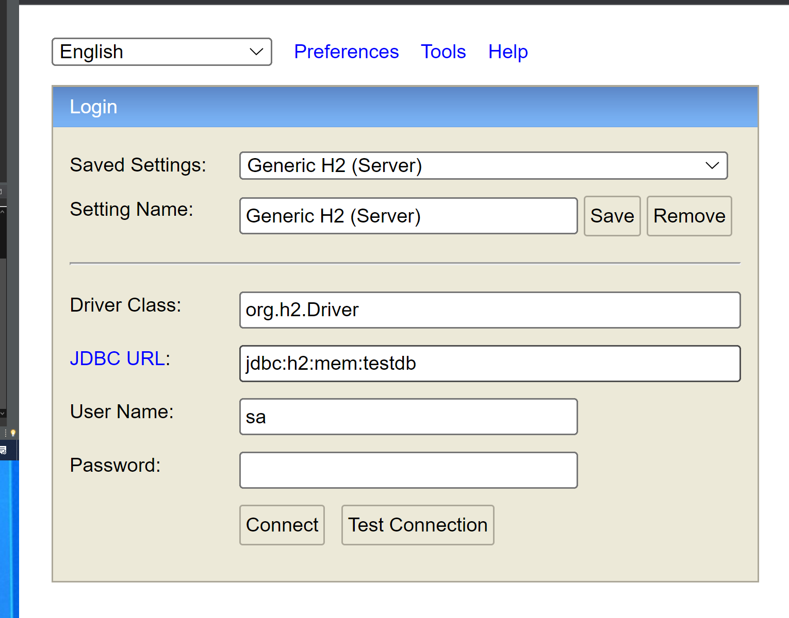
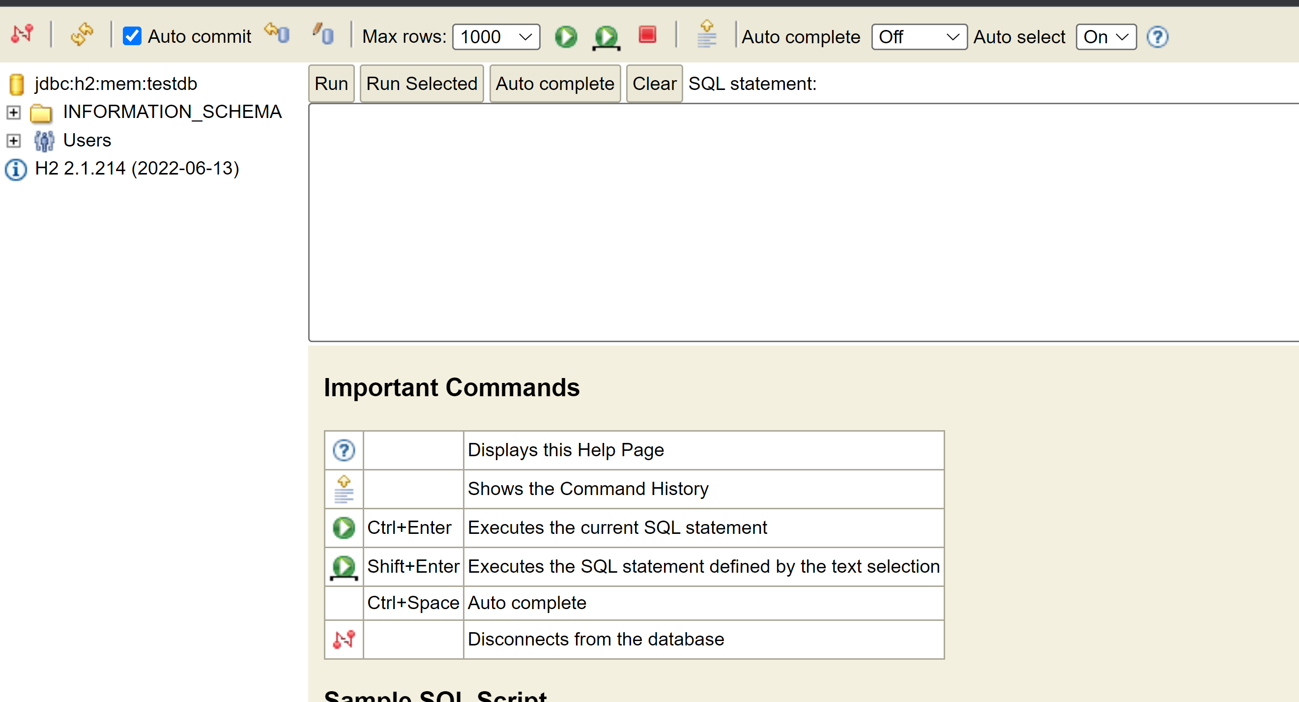
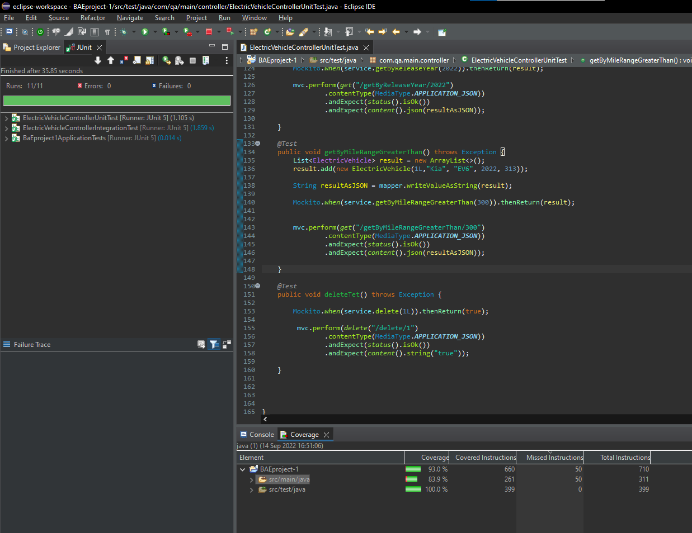
Testing
Tested as I went along - i.e. Test environment
Integration Test / Unit Test
83.9% achieved from integration test and Controller unit test
Service unit test outstanding

Slide 7
Demo

Slide 8
Sprint Review
Completed
Jira Board demo
In progress
Jira Board demo
Left Behind
Jira Board demo

Slide 9
Sprint Retrospective
What went well
API
Enjoyed the creating and testing within eclipse.
Testing in postman – small victories
Testing
Seem to grasp this quickly
Front End
Quick view, easy to format within CSS
Like the split within JS CSS and HTML file
Documentation
What didn’t go well
Creating the table within JS

Slide 10
Conclusion

